Slide 1
Introduction to python scripting
Instructor: Sai Krishna Kovi

Slide 2
Topics covered
Installation
First Python Program, Hello world, Data type Variables
Data structures(Lists, Tuples, Dicts, Sets)
Loops Iterators, File I/O
Using Python Modules (Json, Yaml, Requests etc.)
Introduction of Advanced python like List Comprehensions, Generators etc.

Slide 3
Python
High Level
Intrepreted
Scripting
Mostly used scripting Languages in DevOps: Shell,Python & Ruby
Mostly Used for automation
What is automation
Free & Open Source
High level
Portable(Windows, Linux, MAC)
Extensible(can Integrate with Other Languages like JAVA/.NET)

Slide 4
There are so many applications of Python in the real world.
But over time we’ve seen that there are three main applications for Python
Data Science (including Machine Learning)
Data Analysis/Visualization
Also, it has applications in game development, desktop applications, embedded applications or scripting.

Slide 5
Python
Python can import lot of third party modules (boto3)
Why python is a scripting language?
What is scripting language?

Slide 6
Scripting for automation
Automation?
Repetitive Task
For Productivity
Time saving
Reducing employee Power
Tools Make it Easier
AWS Automation
Automation tools like Ansible, Chef and puppet

Slide 7
Where we Use Python As a DevOps Engineer
When we come across automation we use a lot of python scripting
Python has vast number of libraries
We use those libraries to write scripts which can communicate with system(windows, Linux)
Now a days Linux systems are coming with bundle of python libraries
Configuration management like Ansible is made with Python Language.
Cloud (Boto3)and DevOps Automation can be done with Python Scripting

Slide 8
Installation
Installation (first task)
Learn about installing in Linux(Debian/CentOS),MacOS,Windows.
Set up the path manually
Check for version once after installing(python --version/python --v)
Install ubuntu application in windows and try linux based installation

Slide 9
Installation
*nix systems(Linux, MacOS) Contains Python Default Installed.
Microsoft Windows does not come with any version of Python.
The easiest way to check for Python 3 on your Linux or Mac OS X system is to get to a command line.
On Linux, look in your Applications menu for a program called Terminal. (It may be in a submenu like Accessories or System.)
On Mac OS X, there is an application called Terminal.app in your /Application/ Utilities/ folder. Once you’re at a command line prompt,
just type python3 (all lowercase, no spaces) and see what happens.
On my home Linux system, Python 3 is already installed, and this command gets me into the Python interactive shell. 3

Slide 10
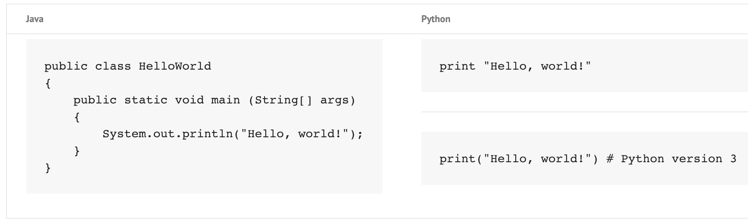
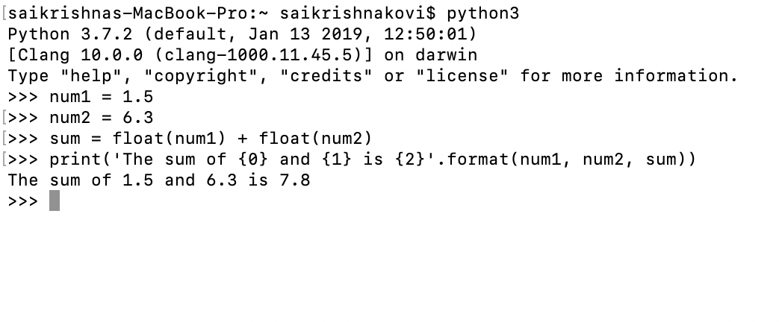
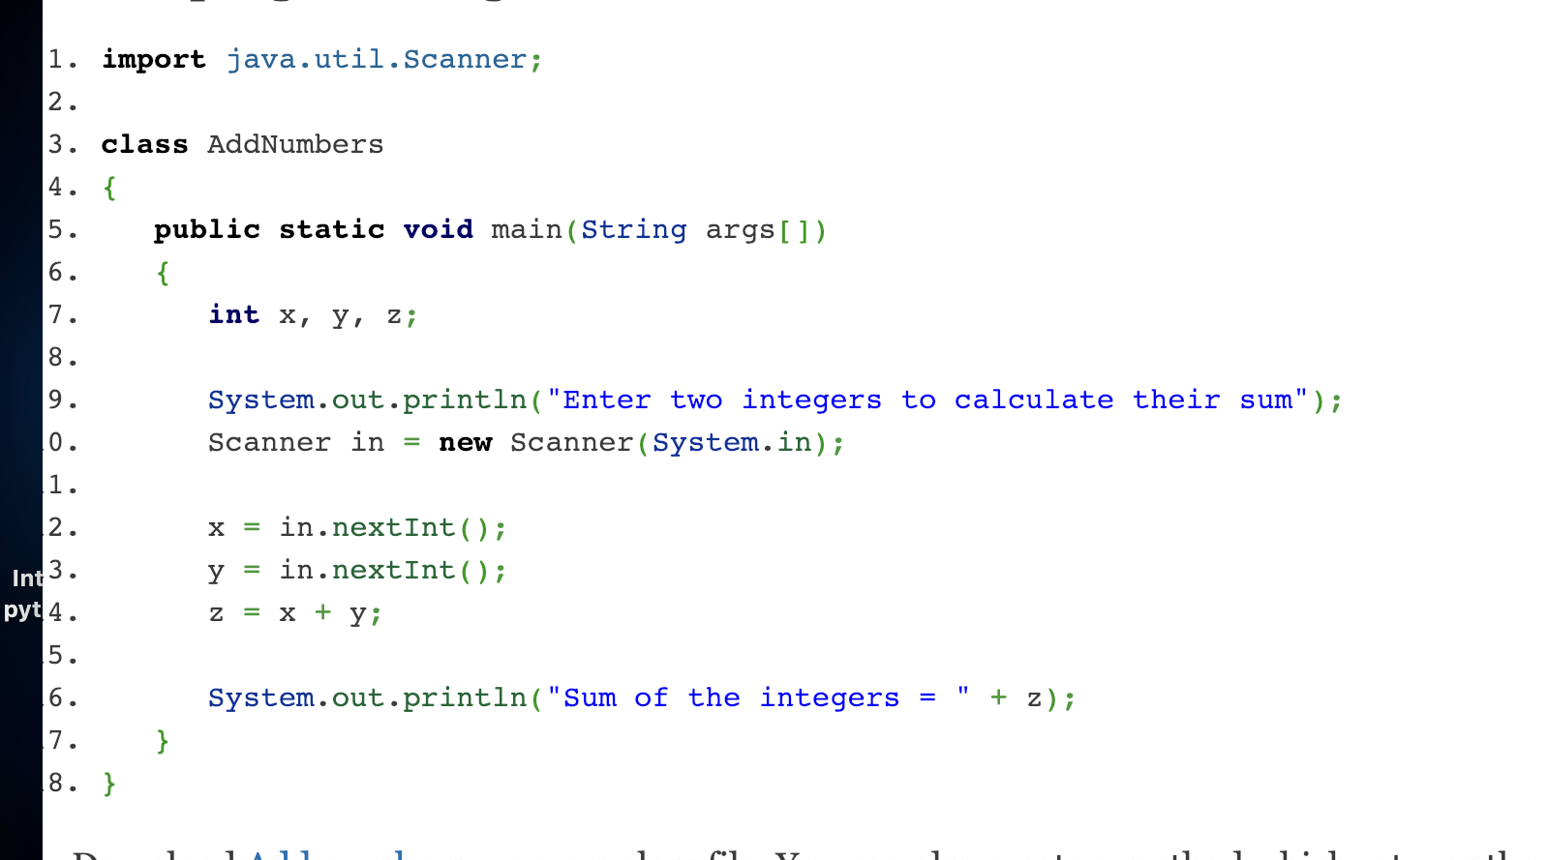

Slide 11
Hello world!
Print (“Hello world”)
Res:Hello world
“I want every one to type the above command in python ide and see whether you get the same”
Executing Hello world as a script file
Open a notepad
Type the above print statement
Save it as Hello world.py
Go to your cmd/Python shell and type python helloworld.py
Res??

Slide 12
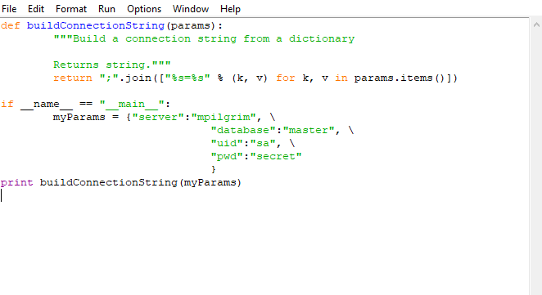
First Python Programm
Source:Dive into PYTHON3

Slide 13


Slide 14
Functions
A function is block of reusable code to perform related operation
High availability of code reuse
Python by Default has many Builtin functions like FLOAT( ),PRINT( ),COMPILE( )
https://docs.python.org/3/library/functions.html
Apart from built in functions we can create our own user defined functions
Def functionname (parameters) :
http://histo.ucsf.edu/BMS270/diveintopython3-r802.pdf

Slide 15
Objects in python
In Python Language everything is an object
String,Lists,Function or whatever you take it is treated as a object

Slide 16
Variables
Variables are nothing but reserved memory locations to store values.
This means that when you create a variable you reserve some space in memory.
Based on the data type of a variable, the interpreter allocates memory and decides what can be stored in the reserved memory.
Therefore, by assigning different data types to variables, you can store integers, decimals or characters in these variables.
Assigning Values to Variables Python variables do not need explicit declaration to reserve memory space. The declaration happens automatically when you assign a value to a variable.
The equal sign (=) is used to assign values to variables.
The operand to the left of the = operator is the name of the variable and the operand to the right of the = operator is the value stored in the variable.

Slide 17
Variables
fruits = 100
distance= 1000.0
name = "John"
a = b = c = 3
Here, an integer object is created with the value 3, and all three variables are assigned to the same memory location.
You can also assign multiple objects to multiple variables. For example
a, b, c = 23,25,"kovi"
Here, two integer objects with values 1 and 2 are assigned to variables a and b respectively, and one string object with the value "john" is assigned to the variable c.

Slide 18
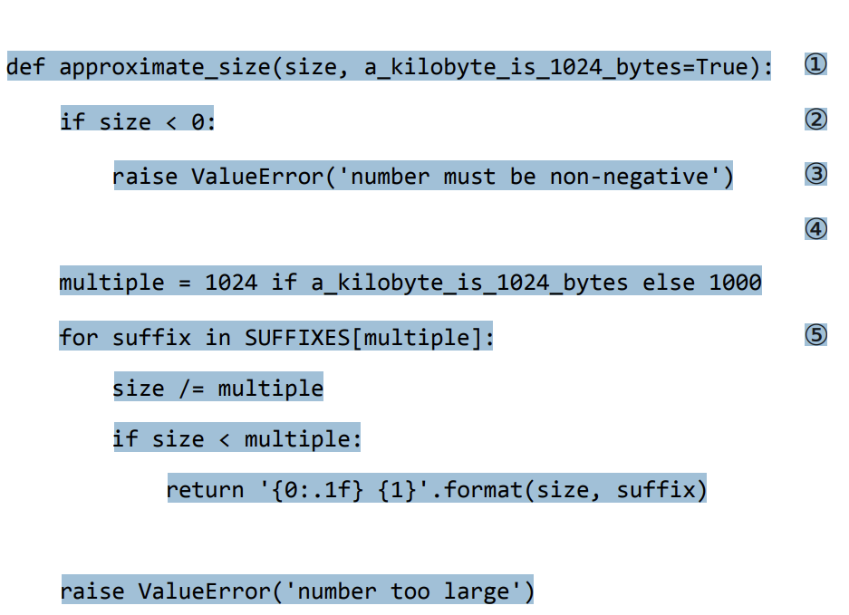
Indenting the code
Python code has no detailed Begin or end
No curly braces to mark it start or where it stops
The only thing we use is a column and
indenting the code
Source:Dive Into Python

Slide 19
DATA TYPES
Dictionaries
Lists
Tuples
Variables
Strings

Slide 20
Tasks to do
Install python for Mac
If windows install python through exe and also install it in vm(ubuntu application for windows)
Study Installation and first chapter in Dive in to python3
Write a document on what you understand from the first chapter.
What are the changes between python 2 and python why we have to use python 3 .
What is an object,What is an object in Python How it Differs from other languages.
Avoid duplication in work
how to port a code from 2.7 to 3.xx versions
Take a python 2 program and change it into python 3 and write what have changed
Submit by tomorrow By 2pm CST

